Slide 1
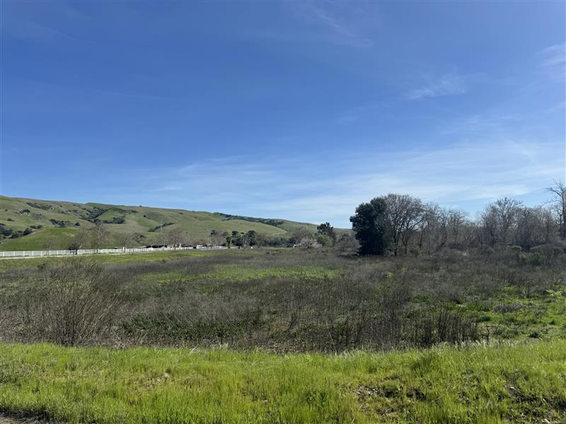
LS Power Grid California (LSPGC) Power Santa Clara Valley Project
(CPUC Application A.24-04-017)
Draft Environmental Impact Report (DEIR)
Public Meeting Presentation
August 5, 2025
California Public Utilities Commission (CPUC)
Energy Division

Slide 2
Meeting Agenda
Overview of the Project
Overview of the DEIR
  Public involvement to date
  Key environmental issues
Project Milestones
Next Steps
  Overview of the CPUC’s Decision and Review Processes
Public Comments

Slide 3
CEQA Review Team
State Lead Agency (CEQA):
California Public Utilities Commission (CPUC)
  Tharon Wright, CPUC Project Manager
Consultant: Environmental Science Associates (ESA)
Valisa Nez, ESA Project Manager
Vince Molina, ESA Deputy Project Manager

Slide 4
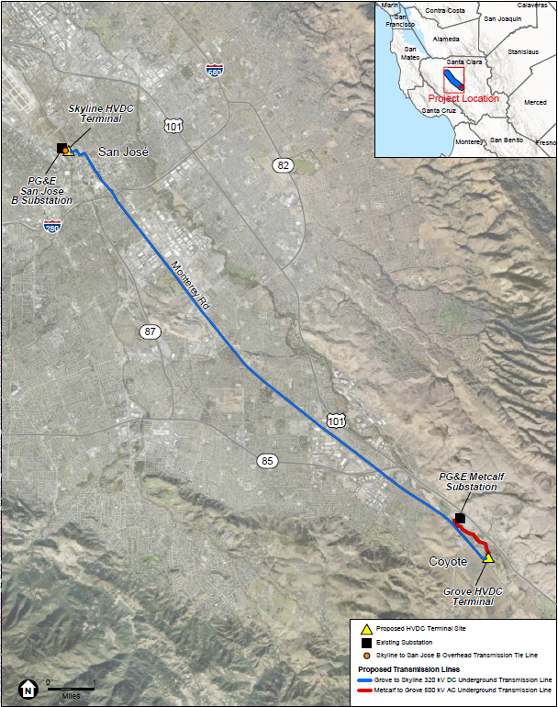
Project Overview
Applicant: LS Power Grid California, LLC
Location: City of San José, Santa Clara County
Application type: Certificate of Public Convenience and Necessity (CPCN)
  Filed April 29, 2024
  Amended March 7, 2025
CEQA document type: EIR
CAISO in-service date: June 1, 2028 (from CAISO 2021-2022 transmission plan)

Slide 5
Project Objectives
Meet CAISO’s reliability-driven need by addressing near-, mid-, and long-term reliability issues in the San José 115 kV system
Meet CAISO’s technical specifications
Improve and maintain the reliability of the transmission grid
Facilitate deliverability of energy from existing and proposed renewable generation projects to the Greater San Francisco Bay Area
Comply with and assist CAISO in meeting applicable Reliability Standards and Criteria
Provide a suitable foundation for future grid upgrades expected to be needed to serve the long-term forecasted electricity load in the San José area, as identified by CAISO

Slide 6
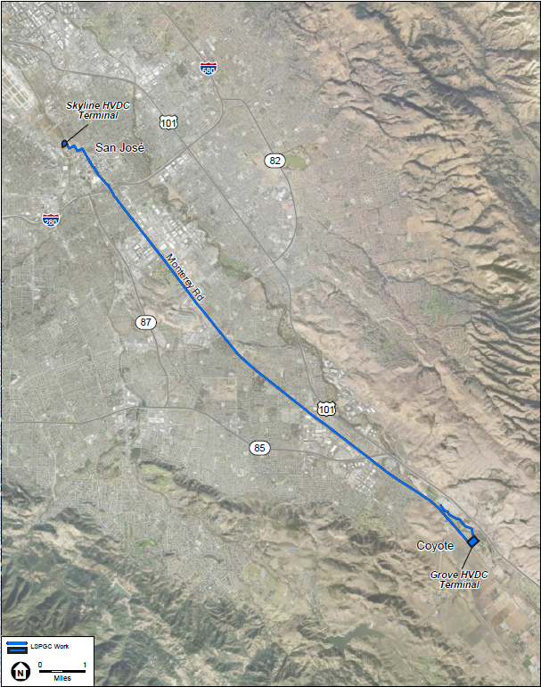
Project Components
LS Power Grid California, LLC
Construction and operation of:
  Proposed Grove to Skyline 320 kV direct current (DC) Transmission Line
  Proposed Metcalf to Grove 500 kV alternating current (AC) Transmission Line
  Proposed Skyline to San Jose B 230 kV AC Transmission Tie Line
  Proposed Skyline high-voltage direct current (HVDC) Terminal
  Proposed Grove HVDC Terminal

Slide 7

Project Components
PG&E
Expansion and modifications to the PG&E San Jose B Substation
  Existing PG&E San Jose B Substation occupies 2.1 acres in the city of San José at the intersection of Coleman Avenue and Santa Teresa Street

Slide 8
Project Components
PG&E
Modifications to the PG&E Metcalf Substation
  Existing PG&E Metcalf Substation occupies 47 acres in unincorporated Santa Clara County near the intersection of Metcalf Road and Monterey Road

Slide 9
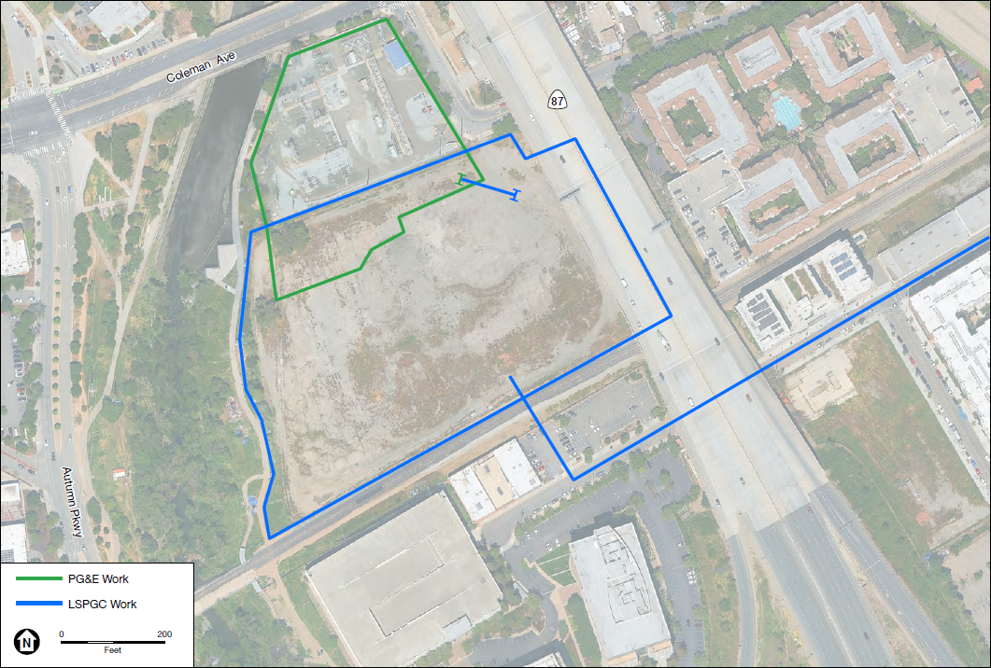
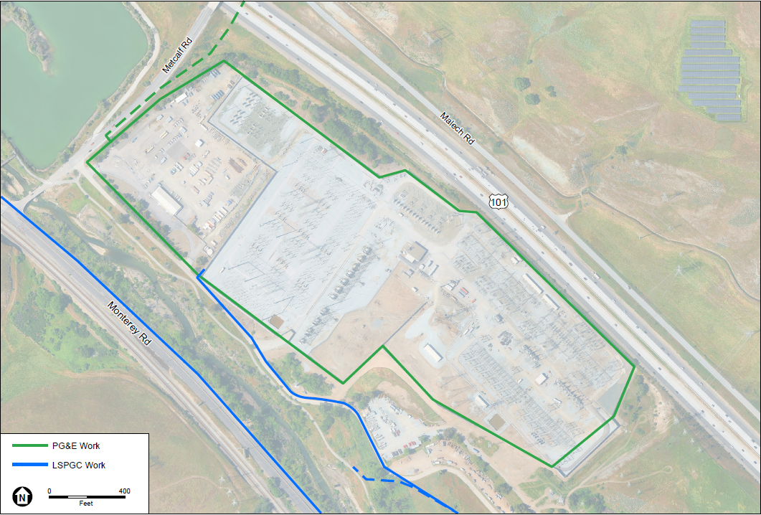
PG&E Interconnection
Existing PG&E San Jose B Substation
Existing PG&E Metcalf Substation

Slide 10
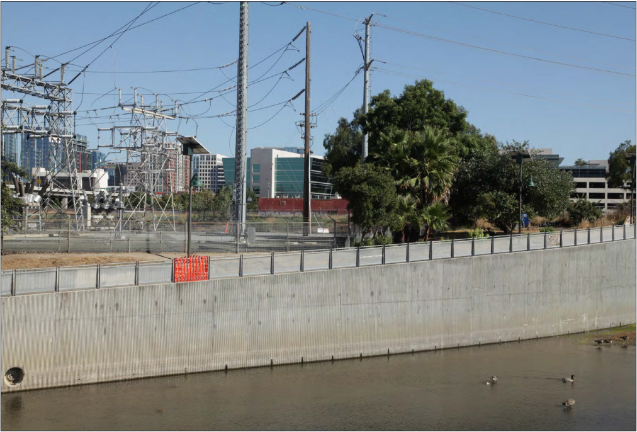
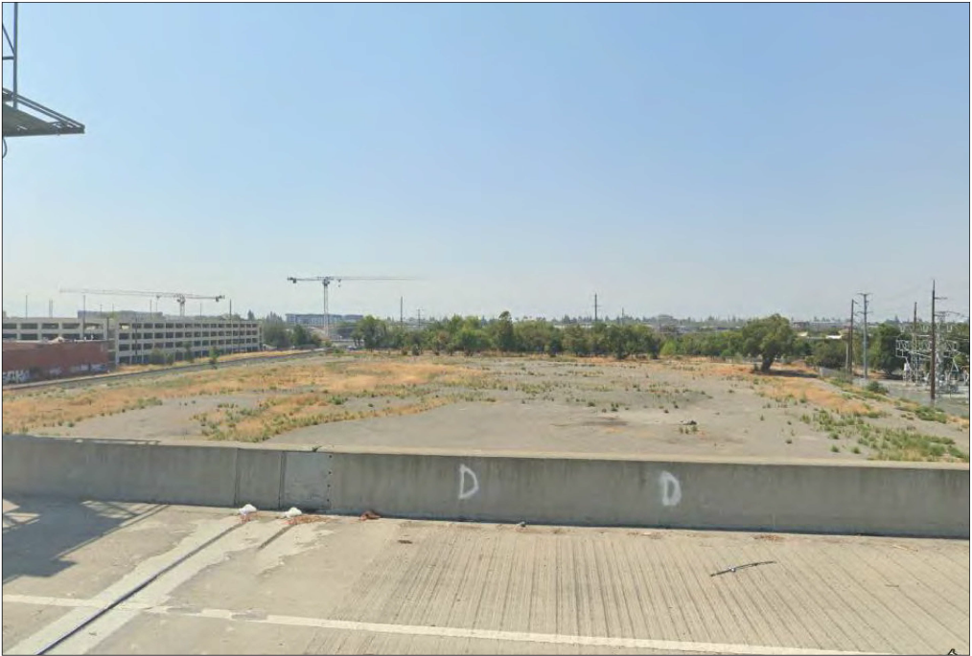
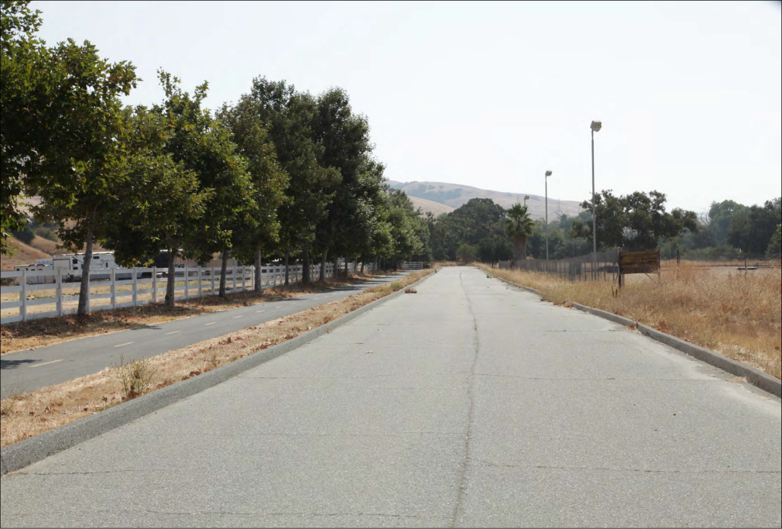
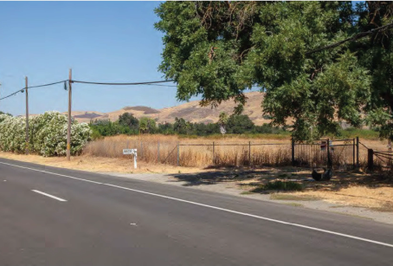
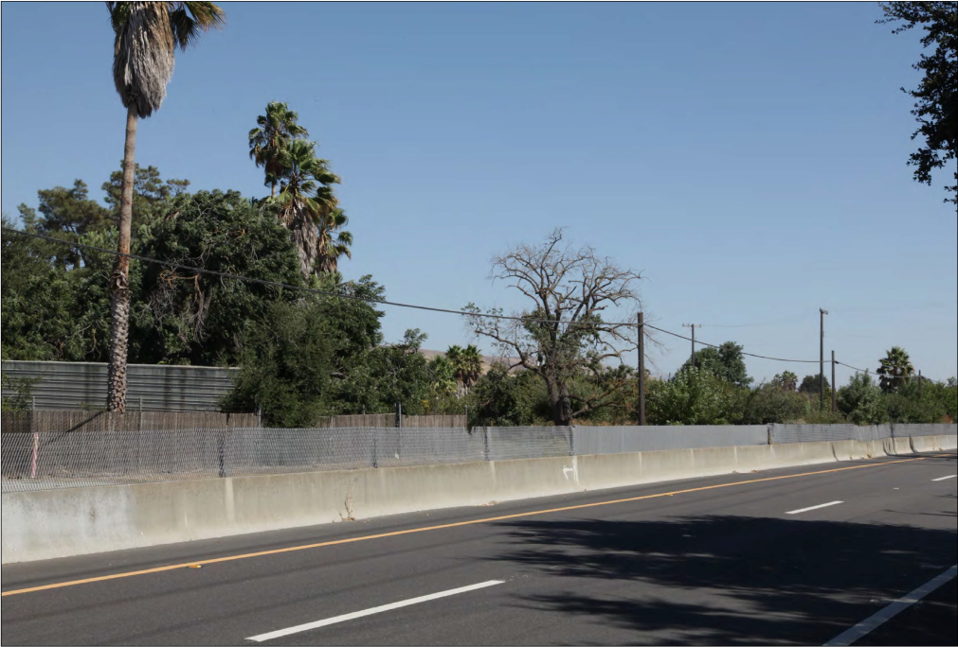
Existing Environmental Setting
Near PG&E San Jose B Substation
Proposed Skyline HVDC Terminal
Coyote Ranch Road
Monterey Road facing northeast
Monterey Road facing east

Slide 11
Public Involvement
Scoping
  Scoping meeting held September 18, 2024
  Comment letters received from Caltrans, CPUC, Native American Heritage Commission, RWQCB – Region 2, Santa Clara Valley Water District, Santa Clara Valley Open Space Authority, members of the public
Tribes
  The CPUC sent notification letters to 19 representatives from 9 tribes
  AB 52 consultation with four tribes: Costanoan Rumsen Carmel Tribe, Indian Canyon Mutsun Band of Costanoan, Muwekma Ohlone Tribe of the San Francisco Bay Area, and Tamien Nation
Public agencies
  Coordination with the City of San José on January 13, 2025, re: existing facilities

Slide 12
Summary of Impacts
No Impact | Public Services
Less than Significant Impact (with implementation of LSPGC Applicant-proposed Measures and/or PG&E Best Management Practices and Field Protocols) | Energy Geology, Soils, and Paleontological Resources Greenhouse Gas Emissions Hazards and Hazardous Materials Hydrology and Water Quality Mineral Resources Population and Housing Recreation Wildfire
Less than Significant Impact with CPUC-proposed Mitigation Measure(s) | Aesthetics Agriculture and Forestry Resources Air Quality Biological Resources Land Use and Planning Noise Transportation Utilities and Service Systems
Significant and Unavoidable | Cultural Resources Tribal Cultural Resources
Notes:
-In case questions arise about how the CPUC approaches significant and unavoidable impacts under CEQA → through Findings and Statement or Overriding Considerations.

Slide 13
Key Environmental Issues – Mitigation Measure Highlights
Cultural Resources and Tribal Cultural Resources
  Cultural Resources Management Plan (LSPGC)
  Cultural Resources Treatment Plan (PG&E)

Slide 14
Key Environmental Issues – Mitigation Measure Highlights
Biological Resources
  Habitat Restoration and Monitoring
  Protection of Special-status Wildlife
  Compensatory Mitigation
  Compliance with Local Tree Ordinances
Transportation
  Coordinated Traffic Control Plan
Agriculture and Forestry Resources
  Compensatory Mitigation

Slide 15
Project Milestones to Date
April 29, 2024: CPCN Application 24-04-17 filed by LSPGC
June 27, 2024: Application deemed complete by the CPUC
September 6, 2024: Notice of Preparation (NOP) of draft EIR
September 18, 2024: Scoping meeting
November 12, 2024: CAISO Board of Governors approved a modified version of the project
March 7, 2025: LSPGC filed an amended CPCN application
April 4, 2025: Amended application deemed complete by the CPUC
July 10, 2025: Release of Draft EIR
July 10 – August 25, 2025: Public/Agency Review Period

Slide 16
Next Steps
August 25, 2025: End of Draft EIR public review period – 5 p.m.
Q4 2025 (TBD): Final EIR released
  Final EIR will consider & respond to all timely comments
Q1 2026 (TBD): CPUC’s CPCN decision and start of pre-construction coordination
  CPUC will issue a Proposed Decision for 30 days of comment
  CPUC will consider comments on the Proposed Decision
  Commissioners will vote to adopt a Decision that either approves or denies the proposed Project
June 1, 2028: Project in-service

Slide 17
How to Submit Comments on the Draft EIR
Public Comment Mailing Address:
Tharon Wright, CPUC Project Manager
c/o Environmental Science Associates, Attn. V. Nez
575 Market Street, Suite 3700, San Francisco, CA 94105
E-mail: PowerSCV@esassoc.com
Public Comment Deadline: 5 p.m. on August 25, 2025
CPUC Project Webpage:
https://ia.cpuc.ca.gov/environment/info/esa/pscv/index.html

Slide 18
Public Comment

Slide 19
Discussion Guidelines
Be concise
Stay on topic
Respect others’ opinions
Comments will be recorded
Written comments are encouraged

Slide 20


Public Comments
Via the Zoom Platform
Click the “Raise Hand” icon
to be called on
By Telephone
Dial *9 to request to raise hand

Slide 21
Thank You for Joining & Your Interest!
Mailing Address:
Tharon Wright, CPUC Project Manager
c/o Environmental Science Associates, Attn. V. Nez
575 Market Street, Suite 3700, San Francisco, CA 94105
E-mail: PowerSCV@esassoc.com
Public comments will be accepted through August 25, 2025
CPUC Project Webpage: https://ia.cpuc.ca.gov/environment/info/esa/pscv/index.html

